Slide 1
Wegner’s Theory of Continental Drift

Slide 2
By the end of this lesson, you should be able to:
Describe the theory of continental drift.
Discuss evidence to support the theory.
Examine key pieces of fossil evidence.
Explain why the theory was not accepted by scientists.

Slide 3
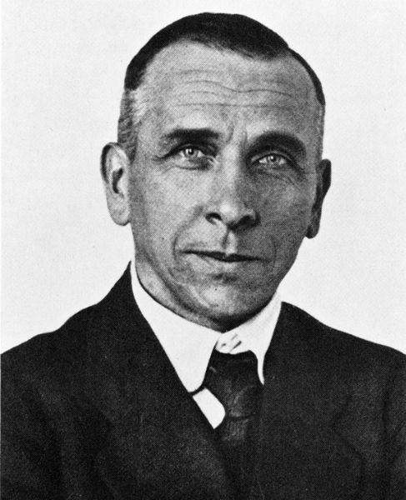
Back then, a German scientist called Alfred Wegener proposed a bold theory that he called continental drift. He said that Earth's continents moved over time and were once joined together in a giant landmass called Pangaea. Think about that for a moment; entire continents moving through the oceans! Where on Earth did he get that idea from?

Slide 4
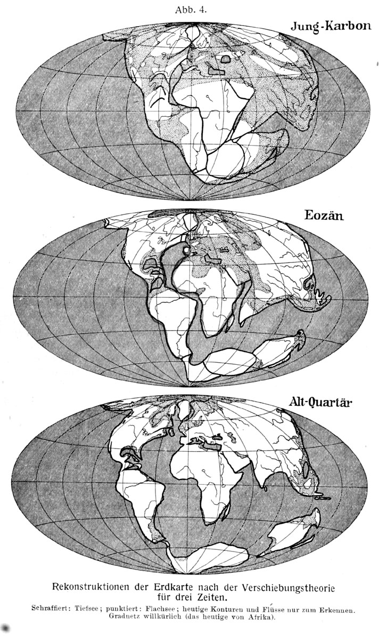
By looking at the shapes of the continents, Wegener suggested that the continents had moved.
According to the theory of continental drift, Earth's continents were once joined together. Logically, they must have moved in order to reach today's positions.

Slide 5
Wegener had four key pieces of evidence for his theory of continental drift.
Coastlines of the continents appear to fit together.
Fossils of the same species had been found on different continents.
Identical rock formations and features were found on different continents.
Evidence of drastically changed climates, such as of glaciers in tropical regions.

